Slide 1
80286/80386

Slide 2
Intel 80286
The Intel 80286 is a high-performance 16-bit microprocessor with on-chip memory protection capabilities primarily designed for multiuser/multitasking systems.
The 80286 can address 16 megabytes (2²⁴) of physical memory and 1 gigabyte (2³⁰) of virtual memory per task.
The 80286 can be operated at several different clock speeds. These are 4 MHz (80286-4), 6 MHz (80286-6.), 8 MHz (80286).

Slide 3
The 80286 has two modes of operations. These are real address mode and protected virtual address mode (PVAM).
The 80286 includes special instructions to support operating systems. For example, one instruction can end a current task execution, save its state, switch to a new task, load its state, and begin executing the new task.
The 80286's performance is up to six times faster than the standard 5-MHz 8086. The 80286 is housed in a 68-pin leadless flat package.

Slide 4
The 80286 memory management features provide the operating system with the following capabilities­
An operating system which can separate tasks from each other. This avoids an 80286 system failure due to task errors.
As tasks begin and end, the operating system can optimize memory usage by moving them around, a process referred to as dynamic relocation.
This is because a program can be executed in different parts of memory without being reassembled or recompiled. Use of virtual memory becomes easy.

Slide 5
Note that virtual memory is a method for executing programs larger than the main memory by automatically transferring parts of the programs between main memory and disk.
Controlled sharing of information between tasks.
The 80286 protection features allow:
An operating system to protect itself from malicious users in a multiuser environment
Critical subsystems such as disk I/O from being destroyed by program bugs under development

Slide 6
Protected Mode Memory Addressing
Protected mode memory addressing (80286 and above) allows access to data and programs located above the first 1M byte of memory.
Addressing this extended section of the memory system requires a change to the segment plus an offset addressing scheme used with real mode memory addressing.
One difference is that the segment address, as discussed with real mode memory addressing, is no longer present in the protected mode.

Slide 7
In place of the segment address, the segment register contains a selector that selects a descriptor from a descriptor table.
The descriptor describes the memory segment's location, length, and access rights.
The difference between modes is in the way that the segment register is interpreted by the microprocessor to access the memory segment.
Another difference, is that the offset address can be a 32-bit number instead of a 16-bit number in the protected mode.

Slide 8
Selectors and Descriptors
The selector, located in the segment register, selects one of 8192 descriptors from one of two tables of descriptors.
The descriptor describes the location, length, and access rights of the segment of memory.
Indirectly, the segment register still selects a memory segment, but not directly as in the real mode.
In the protected mode, this segment number can address any memory location in the entire system for the code segment.
There are two descriptor tables used with the segment registers: one contains global de­scriptors and the other contains local descriptors.
.

Slide 9
The global descriptors contain segment definitions that apply to all programs,
The local descriptors are usually unique to an application.
You call a global descriptor a system descriptor and call a local descriptor an application descriptor.
Each descriptor table contains 8192 descriptors, so a total of 16,384 total descriptors are available to an application at any time.

Slide 10
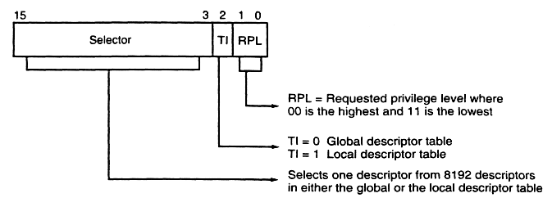
The contents of a segment register
Descriptors are chosen from the descriptor table by the segment register.
The segment register contains a 13-bit selector field, a table selector bit, and a requested privilege level field.
The 13-bit selector chooses one of the 8192’descriptors from the descriptor table.
The TI bit selects either the global descriptor table (TI = 0) or the local descriptor table (TI = 1).
The requested privilege level (RPL) requests the access privilege level of a memory segment. The highest privilege level is 00 and the lowest is 11. If the requested privilege level matches or is higher in priority than the privilege level set by the access rights byte, access is granted.

Slide 11
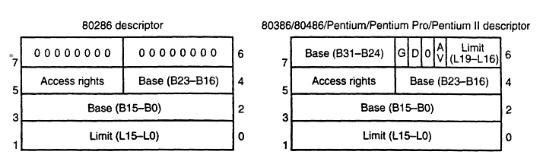
The descriptor formats for the 80286 and 80386 microprocessors.

Slide 12
The descriptor for the 80286 and 80386 microprocessors.
each descriptor is 8 bytes in length.
The base address indicates the starting location of the memory segment.
For the 80286 microprocessor, the base address is a 24-bit address, so segments begin at any location in its 16M bytes of memory.
The 80386 and above use a 32-bit base address that allows segments to begin at any location in its 4G bytes of memory.
The segment limit contains the last offset address found in a segment.
The access rights byte controls access to the protected mode memory segment. This byte describes how the segment functions in the system.

Slide 13
The descriptor for the 80286 and 80386 microprocessors.
each descriptor is 8 bytes in length.
The base address indicates the starting location of the memory segment.
For the 80286 microprocessor, the base address is a 24-bit address, so segments begin at any location in its 16M bytes of memory.
The 80386 and above use a 32-bit base address that allows segments to begin at any location in its 4G bytes of memory.
The segment limit contains the last offset address found in a segment.
The access rights byte controls access to the protected mode memory segment. This byte describes how the segment functions in the system.

Slide 14
80286 Memory Management
The 80286 logical segments may be called virtual segments because all of them may not be resident in physical memory at the same time.
A 80286 logical segment can be of any length from 1 byte to 64K bytes.
The segments presently used by a task are stored in physical memory..

Slide 15
In PVAM, all 24 address pins are. used and therefore, the directly addressable (physical) memory is 16 megabytes
While writing 80286 programs in PVAM, one can refer to the current segment by the assigned names:
For example, if a segment called JOHN is to be used as the current data segment, then the following instructions should be used to load JOHN into DS:
MOV BX, JOHN
MOV DS, BX.
When the 80286 executes the above instruction segment, it will use JOHN as the current data segment. If the segment JOHN is not currently resident in Physical memory, the 80286 will generate an interrupt. A service routine is written to load this segment from disk to physical memory and then resume execution of the main program.

Slide 16
In PVAM, when a program is assembled, a descriptor (8-byte wide) is assigned to each segment.
The descriptor contains information such as segment length in bytes, 24-bit base address where the segment is located in physical memory and the privilege level,
The descriptors are held in tables in main memory and are read into the 80286 as needed.
There are two main types of descriptor tables. These are the global and the local descriptor tables.

Slide 17
The global descriptor table includes information such as the descriptors for the operating system segments and the descriptors for segments which are accessed by user tasks.
A local descriptor is created in the system for each task. All tasks share a global descriptor table with the memory areas specified by its descriptors. Also, each task contains its own local descriptor table with the memory areas specified by its descriptors.
In PVAM, all programs are written using segments. Each segment is assigned with an 8-byte descriptor which includes the length, starting address, and access rights for that segment.

Slide 18
Segment descriptors for programs are stored in memory either in the global descriptor table or in a local descriptor table.
The 80286 memory management is based on address translation.
That is, the 80286 translates logical addresses (addresses used in programs) to physical addresses (addressing required by memory hardware).
The 80286 memory pointer includes two 16-bit words: one word for a segment selector and the other as in offset into the selected segment..

Slide 19
The real and virtual modes compute Physical addresses front these selector and offset values in different ways.
In the real address mode, the 80286 computes the physical address from a 16-bit (selector) content and a 16-bit offset just like the 8086/80186.
It shifts the 16-bit selector four times to the left and then adds the 16-bit offset to determine the 20-bit physical address.
As mentioned before, even though the 80286 has 24 address pins (A0-A23), in the real address mode pins A0­A19 are used.

Slide 20
In the Protected Virtual Address Mode (PVAM or virtual mode for short), the 32-bit address is called a virtual address.
Just like the logical address, the virtual address includes a 16­bit selector and a 16-bit offset.
The 80286 determines the 24-bit physical address by first obtaining a 24-bit value from a

Slide 21
table in memory using the segment value (selector) as an index (rather than shifting the segment value 4 times to left as in the real mode) and then adding the 16-bit offset. Figure 4.3,shows the 80286 virtual address translation scheme.
The 16-bit selector is divided into a 13-bit index, one-bit Table Indicator (TI), and two-bit Requested Privilege Level (RPL). The 13-bit index is used as a displacement to access the selected table. Each entry in the table is termed a descriptor.

Slide 22
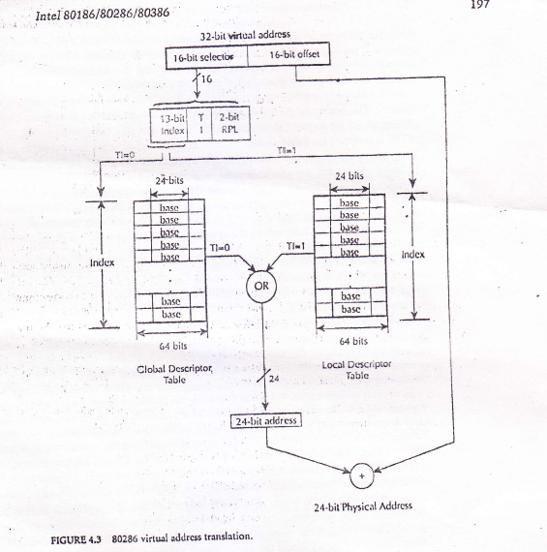

Slide 23
An index can start from a value of 0 to a higher value. The index value refers to a descriptor in the table. For example, index value K refers to the descriptor K.
Each descriptor is 8 bytes wide and contains the 24-bit base address required for physical address calculation.
This address only occupies three bytes of the 8-byte descriptor. The single-bit TI tells the 80286 to select one of two tables: Global Descriptor Table (GDT) and Local Descriptor Table (LDT).

Slide 24
AIl tasks in the 80286 share a common single table called the GDT, while each task has its own LDT.
Therefore, tile 24-bit base addresses required in physical address calculation for segments to be shared by all tasks are stored in the GDT and the base addresses for segments dedicated to a particular task are stored in its LDT.
When TI = 0, the GDT is used as the look-up table, and when Tl = 1, the LDT is used as the look-up table.
The 2-bit RPL is used by the operating system for implementing the 80286's protection features.

Slide 25
RPL is not used in physical address calculation.
The 24-bit physical address is then generated by the 80286 by adding the 24-bit base address of the selected descriptor and the 16-bit offset.
The 24-bit physical address is then generated by the 80286 by adding the 24-bit base address of the selected descriptor and the 16-bit offset.
Note that in the above, when TI = 0 (GDT selector) and Index = 0, a null selector is selected.
The selector does not correspond to the 0th GDT descriptor.

Slide 26
Null selectors can be loaded into a segment register, but use of null selectors in virtual address translation would generate an 80286 exception.
Figure 4.4 shows the 80286 address translation registers. The segment registers CS, DS, SS, and ES have already been discussed before.
The GDT and LDT registers are only used in the 80286 virtual mode address translation. The GDT register stores the 24-bit base address and the length of the GDT (in bytes) minus one.

Slide 27
During system initialization, the GDT is loaded and is usually kept unchanged after this task.
80286 generates an exception when indexing beyond the GDT limit is attempted.
The LDT register stores a 16-bit selector for a descriptor in the GDT which defines the location of the present LDT.
The 80286 task switch operation is invoked by executing an inter-segment IMP or CALL instruction which refers to a task state segment (TSS) or task gate descriptor in the GDT or LDT.

Slide 28
Each task must have a TSS associated with it. The current TSS is identified by a special register in the 80286 called the Task Register (TR).
The TR register makes task switching automatic and very fast.
For example, the 80286 local address space can be modified during task switching by updating the LDT register. Figure 4.5 shows flowchart for accessing memory.

Slide 29
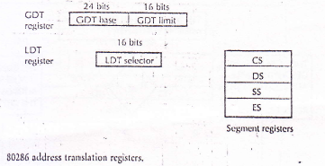

Slide 30
